Slide 1
Using Federal Funds for Summer Learning and Afterschool: A New Guide for Providers, School Districts, and Intermediaries
July 20, 2022
3:30-4:30 PM EDT
Join the conversation at #OST, #summerlearning or #afterschool
Notes:
Good afternoon, I’m Gigi Antoni, director of learning and enrichment at The Wallace Foundation.
Thank you for joining today’s webinar: Using Federal Funds for Summer Learning and Afterschool: A New Guide for Providers, School Districts, and Intermediaries.

Slide 2
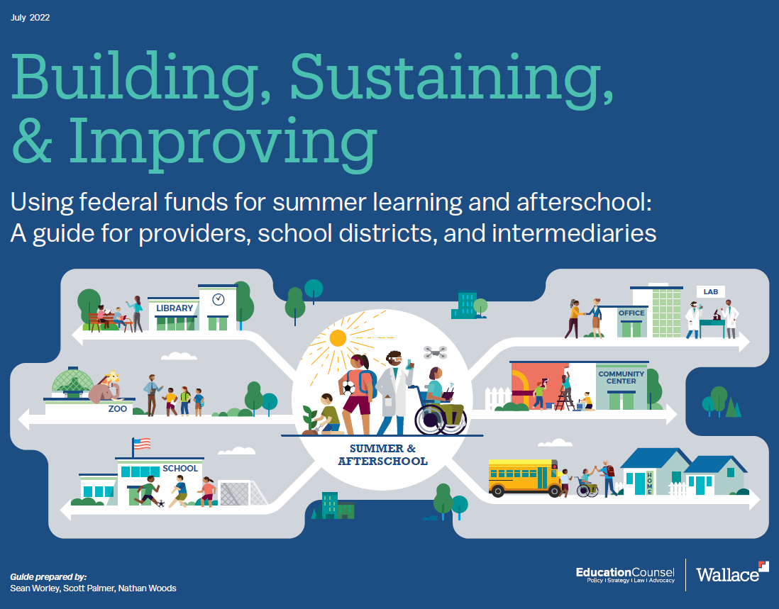
Housekeeping
If you have technical problems, please email events@thehatchergroup.com
To ask a question, please use the Q&A function. The chat function is disabled.
This session is being recorded. The recording and slides will be posted on wallacefoundation.org by Friday
Download Building, Sustaining, & Improving at wallacefoundation.org
Join the conversation at #OST, #summerlearning or #afterschool
Notes:
Before we begin, a few housekeeping items:
If you have technical issues, please email events@thehatchergroup.com
Please post your questions using the Q&A function. The chat function is disabled for this webinar.
The session is being recorded, and the recording and slides will be available by Friday on wallacefoundation.org
You can download the guide at wallacefoundation.org
And, if you are on Twitter, please join the conversation online by using hashtagOST, hashtagSummerlearning or hashtagAfterschool.

Slide 3
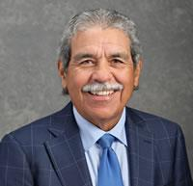
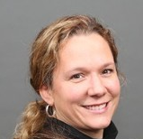
Today’s webinar
Welcome: Why a guide, and why now?
The federal perspective
Shital Shah, Senior Advisor for Strategic Partnerships, U.S. Department of Education
Building, sustaining, & improving: Discussion
Dr. Michael Hinojosa, Former Superintendent, Dallas Independent School District
Barbara Couto Sipe, President and CEO, NextUp RVA, Richmond, Virginia
Nathan Beck, Madison Out of School Time(MOST) Coordinator, Madison, Wisconsin
Gigi Antoni, Director of Learning & Enrichment, The Wallace Foundation
Q&A
Introducing the guide
Sean Worley, Policy Adviser, Education Counsel
Q&A
Shital Shah
Michael Hinojosa
Barbara Couto Sipe
Nathan Beck
Sean Worley
Notes:
Our goal in the next hour is to leave you with useful ideas for how to fund improved access to high-quality afterschool and summer programs.
I’ll start with a brief overview.
Shital Shah, senior advisor for strategic partnerships at the US Department of Education, will share the federal perspective.
Then, we have a terrific panel with:
Dr. Michael Hinojosa, Former Superintendent, Dallas Independent School District.
Barbara Couto Sipe, President and CEO, NextUp RVA, in Richmond, Virginia
And Nathan Beck, coordinator for Madison Out-of-School-Time, in Madison, Wisconsin.
We’ll take questions and then we’ll hear from Sean Worley, policy adviser for EducationCounsel, who will introduce the new guide.
And we’ll close with more questions from you.

Slide 4
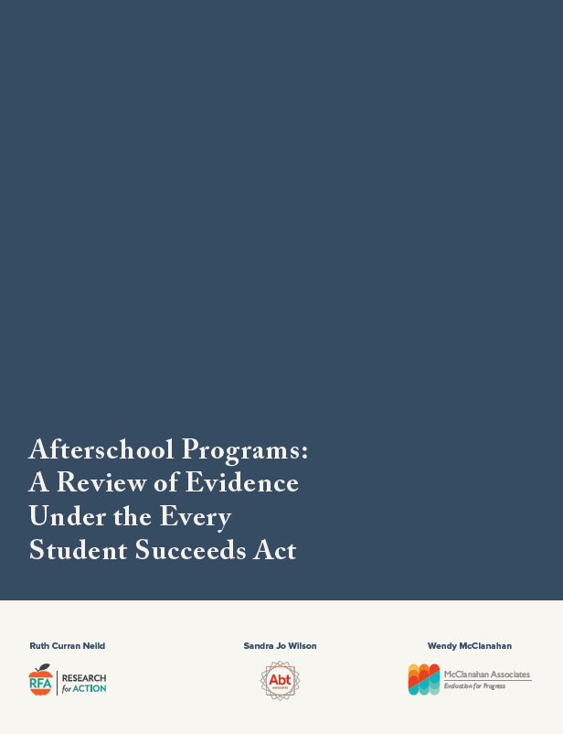
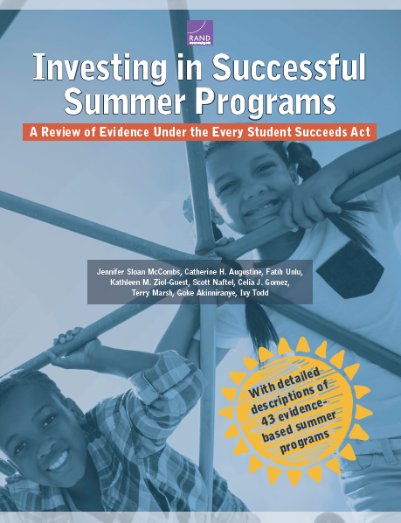
Afterschool and summer programs confer a wide variety of benefits
Academic
Life skills
Career readiness
Health
Safety
“Effective afterschool programs can be found at each grade level and within almost every program type.”
“Summer programs can be an effective mechanism to address the needs of children and youth.”
Afterschool Programs: A Review of Evidence Under the Every Student Succeeds Act, Research for Action, 2019; Investing in Successful Summer Programs: A Review of Evidence Under the Every Student Succeeds Act, RAND, 2019.
Notes:
We’re here today because out-of-school time opportunities (or OST) can confer a range of benefits for young people. Those include:
Academic improvements in reading and math
Life skills, like persistence and teamwork
For older students, improved career readiness
Health benefits from exercise
And even basic safety
A growing body of research has found dozens of effective approaches, with benefits matching program design. For example, a reading program can help in English Language skills – rock climbing can build strength and confidence; and, you can do both to achieve both benefits. In other words, you have choices.
[BUILD]
A 2019 review by Research for Action found more than 60 afterschool programs that met requirements for the top three evidence tiers of the Every Student Succeeds Act or ESSA. Researchers noted that “effective afterschool programs can be found at each grade level and within almost every program type.”
[BUILD]
A similar 2019 review of summer learning programs by RAND found more than 43 programs met ESSA’s top three evidence tiers. The authors found that summer programs “can be an effective mechanism to address the needs of children and youth.”
So it’s clear OST matters – but we face two key challenges.

Slide 5
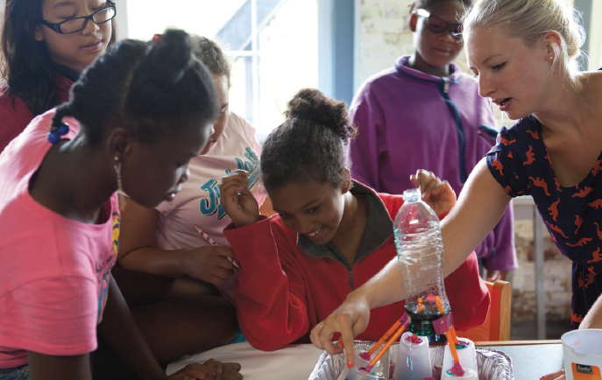
But benefits depend on quality
‘OST programs are beneficial, not magic. Their effectiveness is driven by the content of the program and the experiences.’
-- Jennifer Sloan McCombs, Director of Research, Learning Policy Institute, Adjunct Policy Researcher, RAND
Boston Afterschool & Beyond students at Thompson Island
Notes:
The first is that benefits depend on quality.
As one expert, Jennifer Sloan McCombs put it, OST programs are beneficial, not magic – their effectiveness “is driven by the content of the program and the experiences.”
That means we need to ensure programs are high quality.

Slide 6
And many are missing out
For every child in an afterschool program, an estimated 3 are waiting to get in
An estimated 25 million children aren’t able but would like to access afterschool programs
The gap is larger for low-income, Black and Latinx families
Unmet demand has increased over time
And remained strong during the pandemic
Promoting Healthy Futures: Afterschool Provide the Supports Parents Want for Children’s Well-Being, The Afterschool Alliance, 2022.
Notes:
The, second challenge is inequitable access.
A 2020 survey by the Afterschool Alliance found that for every child in a program, an estimated 3 would attend one if there was a program nearby that they could afford; that’s an estimated 25 million children.
Unmet demand is especially large for those from low-income families, or families of color.
Demand is growing and remained strong in the pandemic when many were feeling isolated and under strain.
So if quality and access matter – what can we do, and how can we pay for it?

Slide 7
How can we expand quality and access?
‘OST programs are beneficial, not magic. Their effectiveness is driven by the content of the program and the experiences.’
-- Jennifer Sloan McCombs, Director of Research, Learning Policy Institute, Adjunct Policy Researcher, RAND
Preparing for program delivery
Physical infrastructure
Human capital
Planning, communication and retention
Building ecosystems of support
Partnerships
Continuous improvement
Creating equitable conditions for learning
Rigorous, engaging and relevant opportunities
Safe, supportive environments
Notes:
There are no silver bullets. But the guide suggests relying on three kinds of actions.
The first, is preparing for program delivery by investing in physical infrastructure, qualified staff, and in careful planning.
The second is building an ecosystem of support – partnerships between schools and community organizations. And since none of us gets things right the first time, continuous improvement is key to quality.
Both of these are the foundation for what’s most important: Creating equitable conditions for learning, with rigorous, engaging opportunities, and safe, supportive environments that give kids what they need, when they need it, and the way they need it.
[BUILD]
As this graphic shows - these elements reinforce each other.
And the guide shows which federal funds can support each.
Because federal funds are important, I’m delighted to introduce Shital Shah, Senior Advisor on Strategic Partnerships for the US Department of Education. Shital was previously director of Philanthropic Engagement at the American Federation of Teachers and served on the 2020 Biden-Harris transition team. Before that, she spent a decade with the national Coalition for Community Schools where she provided strategic support on policy, advocacy and implementation. Over to you, Shital.
Thank you, Shital.
And now I’d like to ask our three distinguished panelists to join. Each will share insights from their vantage point.
Dr. Michael Hinojosa, is the former superintendent of the Dallas Independent School District, having served there 13 years in two separate stints. He’s known as a national leader in integrating summer learning and afterschool, with the help of a 25-year partnership with Big Thought – an intermediary organization in Dallas that connects out-of-school time providers with the school system that serves 150,000 students.
Barbara Couto Sipe is President and CEO, of NextUp RVA, in Richmond, Virginia. NextUp is also an intermediary linking providers and schools. Like the organization it’s modeled on based in Providence, Rhode Island, NextUp focuses on ensuring all Richmond middle school students have access to high-quality learning experiences beyond the classroom. She’s led the organization for 9 years.
And Nathan Beck has been coordinator for Madison Out-of-School-Time in Madison, Wisconsin for the past five years. Nathan is in the unusual position of working half-time for the Madison city government, and half-time for the Madison Metropolitan School District. From his dual perch, he works – often behind the scenes – as an internal advocate for OST.
Let’s begin with you, Dr. Hinojosa. A report by the research organization NWEA released yesterday found that students are slowly starting to regain the academic ground they lost in the pandemic. They’ve recovered about 15-35%. But are still far behind where they would be otherwise. That’s especially true for students of color and from low-income families. Why and how does afterschool and summer fit into what Dallas is doing, and how have you funded it?
Barbara, let’s go to you. NextUp functions as a kind of broker – or system integrator – that sits in between busy school officials and community-based providers. Tell us how this brokering process works – and give us an example of how you keep quality front and center. [Barbara can tell the story of how tracking attendance showed a problem in a STEM class and how NextUp solved it.]
And now to you, Nathan. Can you describe how your dual role works, and I know you have an example from this summer of what it’s allowed the city to do. [Nathan can tell the story of how the district saw a 600-student over-enrollment in summer schools, and how they were able to quickly scramble and pay for places in other OST programs for those turned down.]
I think it’s clear from each of you that partnerships make a difference. But we know they take time and effort. I want to ask each of you, from your perspective, what makes it work.
Let’s start with you, Dr. Hinojosa. What does a school district need from out-of-school time providers?
Barbara – from the vantage point of out-of-school time providers and intermediaries, what does a district need to do?
And Nathan, what can a city do to be a good partner in this effort?
Thanks to each of you.
This conversation illustrates that building quality and access for the long term isn’t only about delivering high-quality programs – it’s also about building an infrastructure to support them.
Our next speaker, Sean Worley, policy advisor at Education Counsel, will give us a preview of how federal funds can be used to do just that.
I’d like to close by asking each our four speakers in a minute each: “what advice would you give on funding afterschool and summer.”
I want to thank each of you for sharing your expertise.

Slide 8
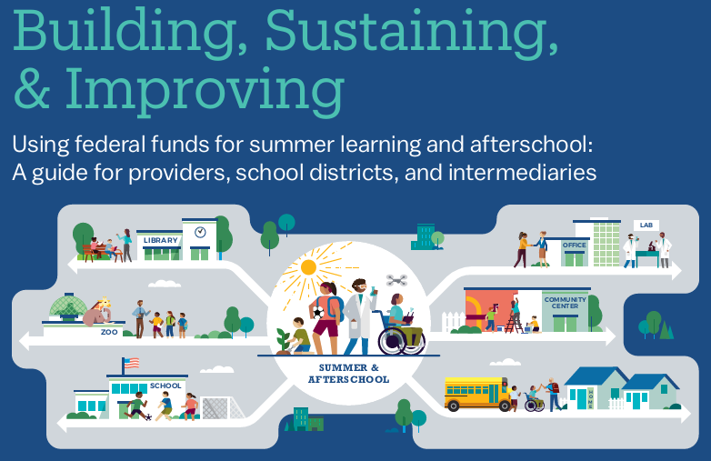
Notes:
Quality summer and afterschool (OST programs) provide meaningful, impactful experiences for youth.
Building, sustaining, and improving programs requires significant resources.
There has been a large influx of federal funds – but there are other funds beyond COVID relief dollars.

Slide 9
A True Community Effort
Afterschool Alliance
American Institutes of Research
Boston Beyond
California Afterschool Network
Every Hour Counts
KP Catalysts
National AfterSchool Association
National Summer Learning Association
Texas Partnership for Out-of-School Time
Andrea Bridges
Sherita Rogers
Stacie Strotman
Katie Conduit
Tafona Ervin
Kim Lewis
Mike Cdebaca
Charmayne Turner

Slide 10
Pathway toward a new resource
What research has found about OST programs
What common elements can be pulled together
How can federal $$ support each of those elements
+
What national leaders know to be true about OST programs

Slide 11
Over 30 Federal programs were reviewed, 24 are included in
Building, Sustaining, & Improving
U.S. Treasury:
American Rescue Plan (ARP) State and Local Fiscal Relief Fund
U.S. Department of Education:
Elementary and Secondary School Emergency Relief (ESSER) II Fund
ARP ESSER Fund
Title I, Part A
Title II, Part A
Title IV, Part A (Student Support and Academic Enrichment Grants)
Title IV, Part B (21st Century)
Title IV, Part F (Promise Neighborhoods)
Title IV, Part F (Full-Service Community Schools)
McKinney-Vento Education for Homeless Children and Youth
IDEA, Part B
U.S. Department of Health and Human Services:
ARP Child Care Stabilization Fund
ARP Child Care and Development Block Grant (CCDBG)
CCDBG
Head Start
Temporary Assistance for Needy Families (TANF)
U.S. Department of Labor:
Youth Formula Program
Workforce Pathways for Youth
Youth Apprenticeships
Corporation for National and Community Service:
AmeriCorps VISTA
U.S. Department of Agriculture:
Child and Adult Care Food Program – Afterschool
National School Lunch Program
Summer Food Service Program
School Breakfast Program

Slide 12
Connecting opportunities in federal resources to each of the elements of high-quality OST programs

Slide 13
Navigating Building, Sustaining, & Improving
PART 1.
Federal Sources to Fund Equitable Conditions for Learning, Preparing for Program Delivery, and Building Ecosystems of Support
PART 2.
About the Federal Funding Sources
PART 3.
Appendix of Additional Resources
Notes:
Part I.
Connects the elements of OST programs (and their discrete actions) to federal funding.
Demonstrates opportunities for blending and braiding.
Identifies opportunities for using existing federal funds differently.
Part II.
Provides additional information on each federal funding stream.
Highlights relevant allowable uses for supporting OST programs.
Links directly to resources from federal government.
Part III.
Lifts up implementation resources from field leaders, evidence on impact of OST programs

Slide 14
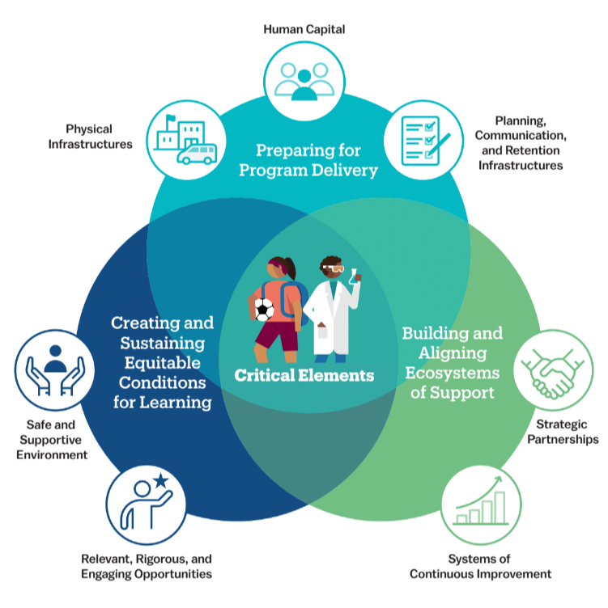
Seven Elements of High-Quality OST Programs
Notes:
Key points:
Collective critical nature of the elements
Intentionality with visualizing all of the elements in an interconnected way because they TRULY are all related to quality OST programs
But recognition of importance of divisibility for strategic attending to specific elements

Slide 15
Seven Elements of High-Quality OST Programs
Notes:
Emphasize all of the other elements as critical and the interconnectedness of them all. Only lifting up Safe/Supportive as an example to demonstrate the guide.
These funds are not new so we hope that it may spark thinking on:
What are all of the options to support activities
How can funds be used differently than how they’ve been used before

Slide 16
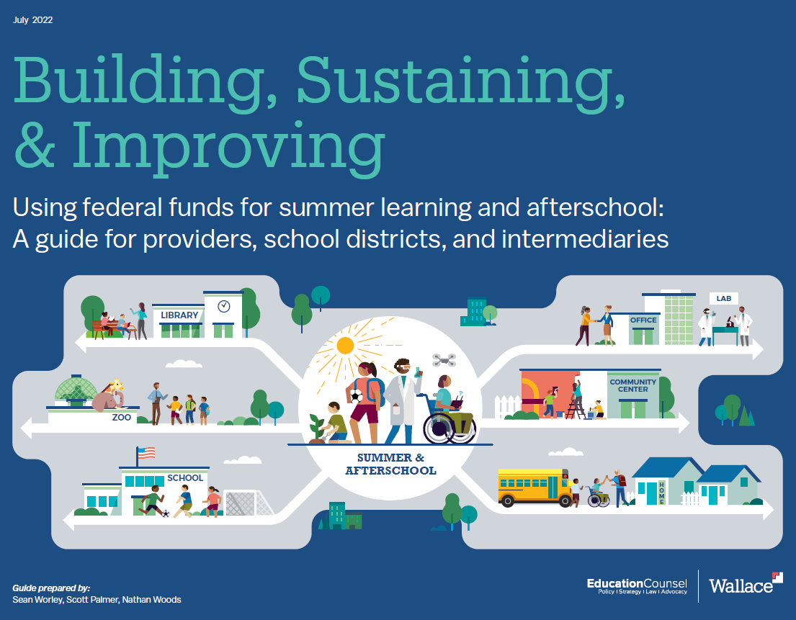
Thank you!
Download Building, Sustaining, & Improving without charge along with other resources on summer learning and afterschool at: www.wallacefoundation.org
A recording of this webinar and these slides will be posted on wallacefoundation.org on Friday
Notes:
In closing, awful impact of the pandemic has elevated attention to afterschool and summer. It’s also provided an influx of federal funds. We have a moment of opportunity now to help kids regain lost ground – but, also, to build for the future.
We hope this webinar and the guide will provide you a few ideas on how to do that.
As a reminder, recording of this webinar and the slides will be posted on wallacefoundation.org on Friday. You can download the guide at wallacefoundation.org, along with other evidence and lessons on putting on high-quality afterschool and summer programs.
Thank you, and have a good afternoon.

